Slide 1
Introduction to Java for Business BU350.700.51 Spring I 2025
Java Strings

Slide 2
The Java String Type
A string is a sequence of characters
String is a pre-defined non-primitive Java type
It’s treated as an object and is part of the built-in Java class library
Type Name
String message = “I like Java!”;
Variable that references a String object with the contents I like Java!

Slide 3
Some String Class Methods
Because Strings are objects there are built-in methods that can operate on them
Method | Description
length() | Returns the length of the string as an int.
substring( idx ) | Returns a new String object consisting of all the characters from the beginning index idx until the end of the original string. There are variations.
charAt( idx ) | Returns the character at location idx.
toLowerCase() | Returns a new String object containing all the characters in the original string, with uppercase characters converted to lowercase.
toUpperCase() | Returns a new String object containing all the characters in the original string, with lowercase characters converted to uppercase.

Slide 4
Creating String Objects
// There are a number of ways to create String objects
//
// The first example creates an empty string.
// The second example calls the String class constructor &
// passes it the string contents.
// The third example uses a simple assignment statement.
public class StringCreateDemo
{
public static void main( String [] args )
{
String s1 = new String();
String s2 = new String(“I like Java”);
String s3 = “Java makes my day!”;
}
}

Slide 5
The length() Method
// The length() method returns the number of characters in a string
public class StringLengthDemo
{
public static void main( String [] args )
{
String s1 = new String();
String s2 = new String(“I like Java”);
String s3 = “Java makes my day!”;
System.out.println();
System.out.println(“Length of s1 is “ + s1.length() );
System.out.println(“Length of s2 is “ + s2.length() );
System.out.println(“Length of s3 is “ + s3.length() );
}
}

Slide 6
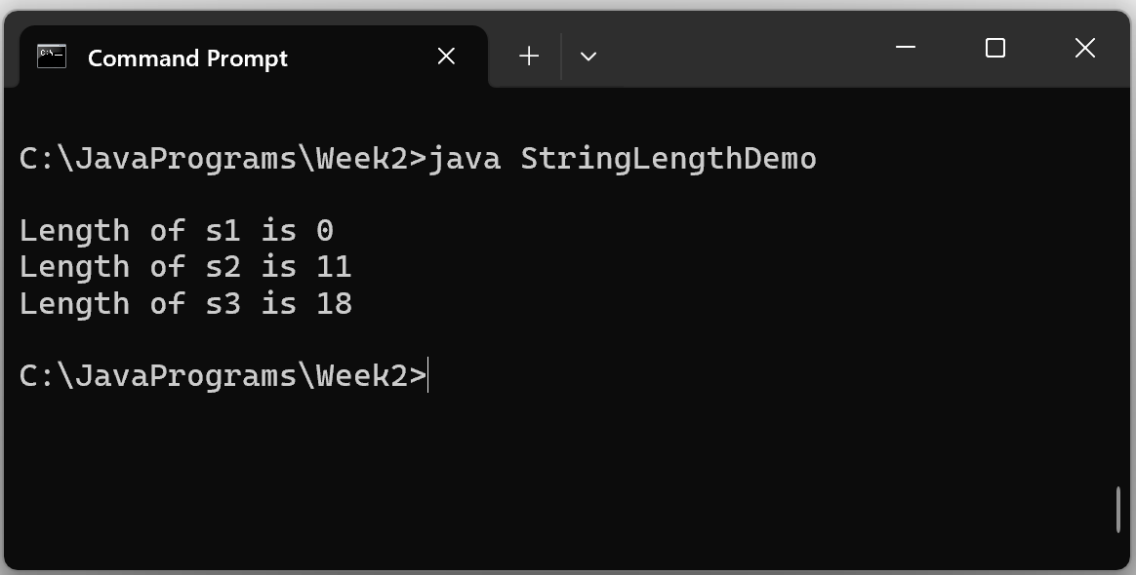
The length() Method
Sample Program Output

Slide 7
The toUpperCase()Method
// The toUpperCase() method returns a String object containing
// all of the characters of the original string with lower case
// characters converted to upper case characters.
public class UpperCaseMethodDemo
{
public static void main( String [] args )
{
String s = new String(“I like Java”);
System.out.println();
System.out.println(“Original String: “ + s );
System.out.println(“Converted String: “ + s.toUpperCase() );
}
}

Slide 8
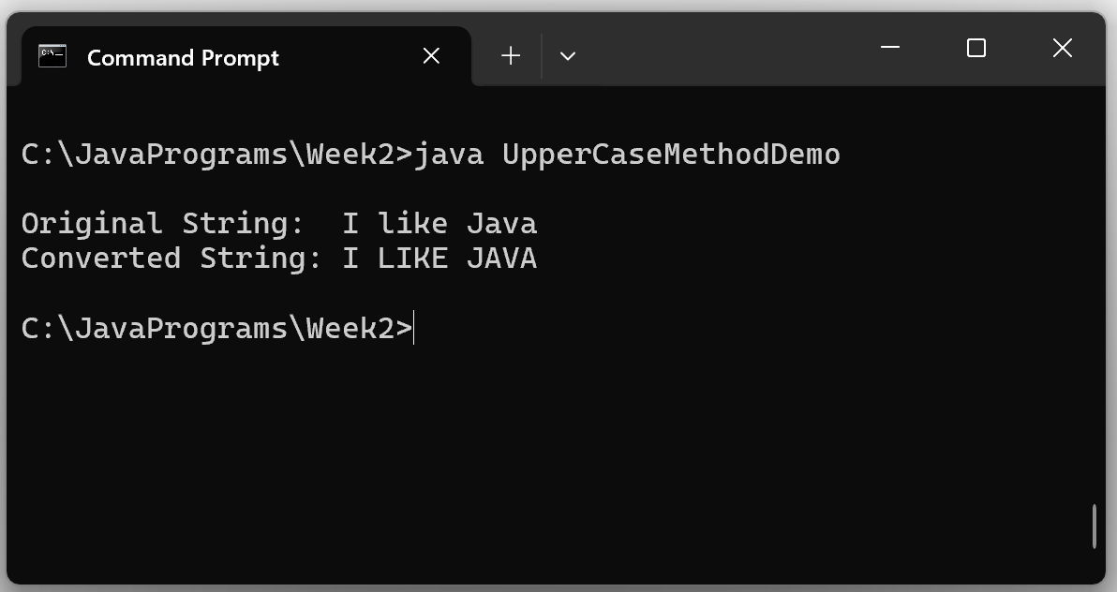
The toUpperCase()Method
Sample Program Output

Slide 9
The substring()Method
// The substring() methods return substrings of an original string.
//
// substring(begin) returns a string from the begin index to end of the
// original string.
// substring(begin, end) returns a string from the begin index to end-1 index.
public class SubstringDemo
{
public static void main( String [] args )
{
String s = new String(“I like Java”);
System.out.println();
System.out.println(“Original String: “ + s );
System.out.println(“substring(6): “ + s.substring(6) );
System.out.println(“substring(0, 5): “ + s.substring(0, 5) );
}
}

Slide 10
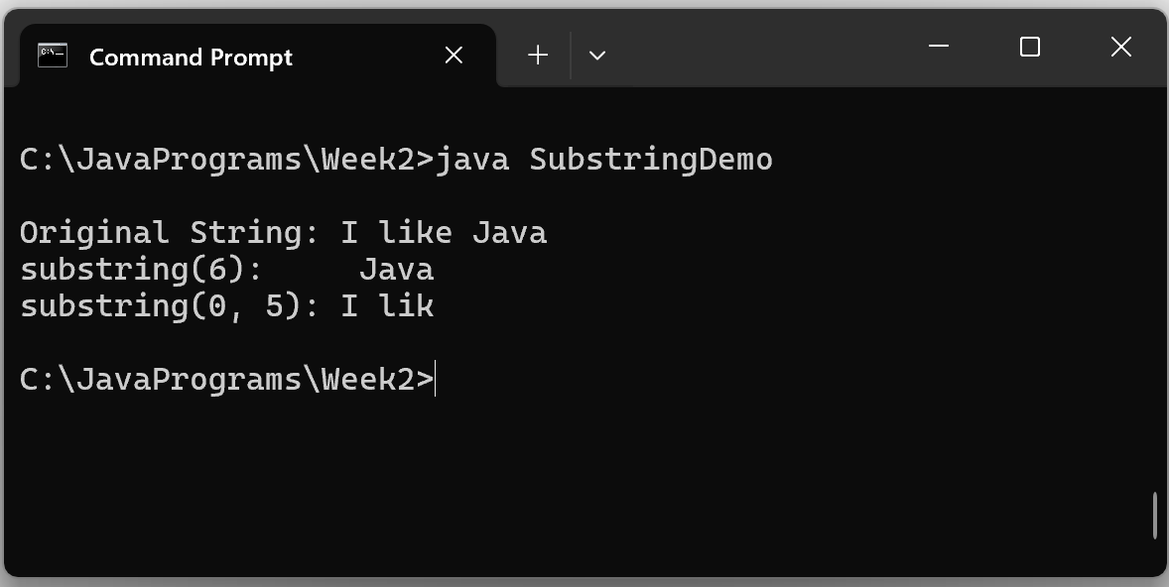
The substring()Method
Sample Program Output

Slide 11
Concatenating Strings
// Program to demonstrate concatenating string objects
//
// Could also use the concat() method.
public class ConcatenateDemo
{
public static void main( String [] args )
{
String s1 = "Hello";
String s2 = "Java World!";
String s3 = s1 + " " + s2;
System.out.println();
System.out.println( s3 );
}
}

Slide 12
Concatenating Strings
Sample Program Output
// Program to demonstrate concatenating string objects
//
// Could also use the concat() method.
public class ConcatenateDemo
{
public static void main( String [] args )
{
String s1 = "Hello";
String s2 = "Java World!";
String s3 = s1 + " " + s2;
System.out.println();
System.out.println( s3 );
}
}

Slide 13
Java Strings are Immutable
You can’t directly change the contents of a String object
// Program to demonstrate that Java String objects are immutable
//
// You can't directly change the contents of a String object because
// a String variable name is just a reference to the contents.
public class ImmutableDemo
{
public static void main( String [] args )
{
String myString = "I like Java";
// You can let myString refer to another object
myString = "good morning";
// You can use substrings & concatenation to refer
// to another object with different contents
myString = myString.substring(6) + "night";
}
}

Slide 14
Java Strings are Immutable
The variable name associated with an object is a REFERENCE to that object.
X
I |  | l | i | k | e |  | J | a | v | a
String myString = “I like Java”;
myString
myString = “good morning”;
g | o | o | d |  | m | o | r | n | i | n | g

Slide 15
Testing for String Equality
// You must use the equals() method to test if the content
// of two strings are equal.
public class StringEqualityDemo
{
public static void main( String [] args )
{
String s1 = "I like Java";
String s2 = "I like C++";
String s3 = "I like Java";
System.out.println();
if( s1.equals(s2) )
System.out.println( "s1 & s2 are equal" );
else
System.out.println( "s1 & s2 are not equal" );
if( s1.equals(s3) )
System.out.println( "s1 & s3 are equal" );
else
System.out.println( "s1 & s3 are not equal" );
}
}

Slide 16
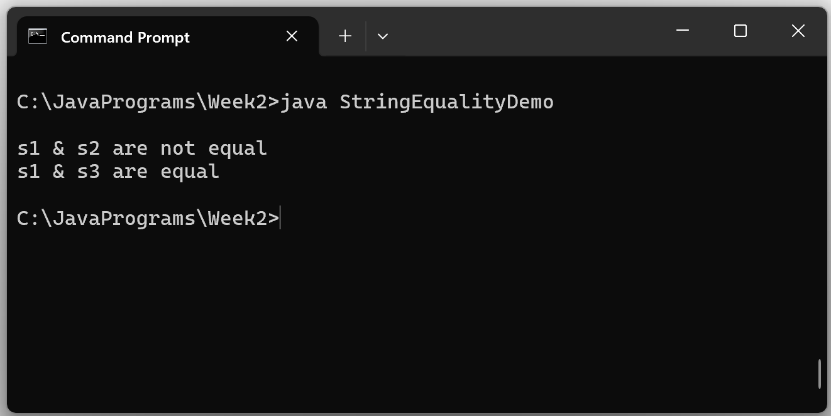
Testing for String Equality
Sample Program Output

Slide 17
Strings Are Passed to Methods By Reference
// In this program displayString() receives a copy of the reference
// variable s...the actual contents of s are not passed. What this
// means is that s and str are both referencing the same block of
// memory.
//
// Program Output: I like Java
public class StringPassingDemo1
{
public static void main( String [] args )
{
String s = "I like Java";
displayString( s );
}
public static void displayString( String str )
{
System.out.println();
System.out.println( str );
}
}

Slide 18
Strings Are Passed to Methods By Reference
// Program to demonstrate that String objects are passed to
// methods by reference. It appears that the called method can
// change the contents of the object passed to it... but it can't.
//
// Program Output: Where's the Beef?
public class StringPassingDemo2
{
public static void main( String [] args )
{
String s = "Where's the Beef?";
System.out.println();
System.out.println( "Original string: " + s );
changeString( s );
System.out.println( "After method call: " + s );
}
public static void changeString( String str )
{
str = "Hello World";
}
}

Slide 19
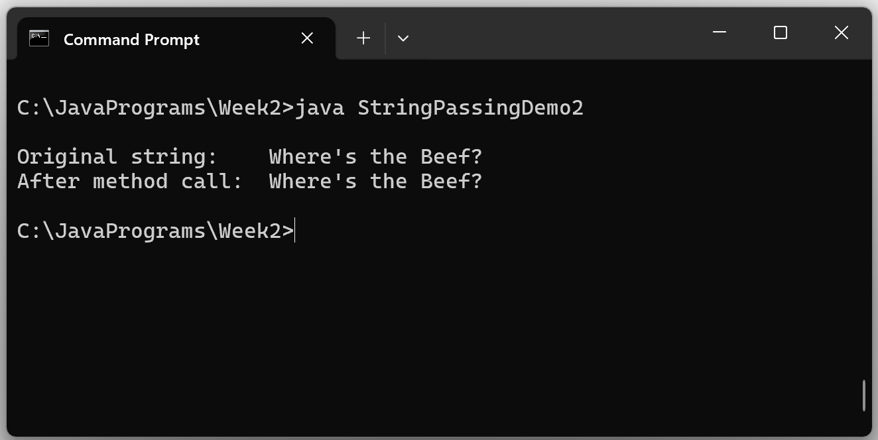
Strings Are Passed to Methods By Reference
Sample Program Output
The original string object contents remains unchanged…let’s see why

Slide 20
Why Wasn’t the Original String Changed?

Slide 21
Returning Strings From Methods
// Program to demonstrate returning a String object from
// a method.
public class ReturnStringDemo
{
public static void main( String [] args )
{
String s = getString();
System.out.println();
System.out.println( "String returned is: " + s );
}
public static String getString()
{
String str = "Hello World";
return str;
}
}

Slide 22
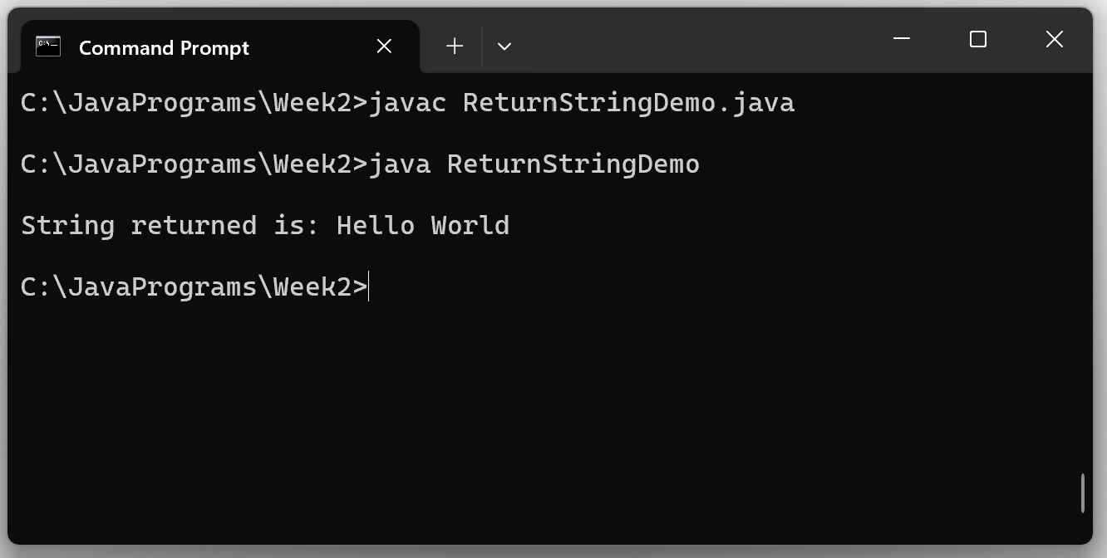
Returning Strings From Methods
Sample Program Output

Slide 23
Handling Command Line Argumens
// Program to demonstrate accessing command line arguments
//
// When a program is invoked from the command line, the
// command line arguments it is invoked with are accessible
// via the args String array
public class CommandArgumentDemo
{
public static void main( String [] args )
{
System.out.println();
for( int j = 0; j < args.length; j++ )
System.out.println( "args[ " + j + " ] is " + args[j] );
}
}

Slide 24
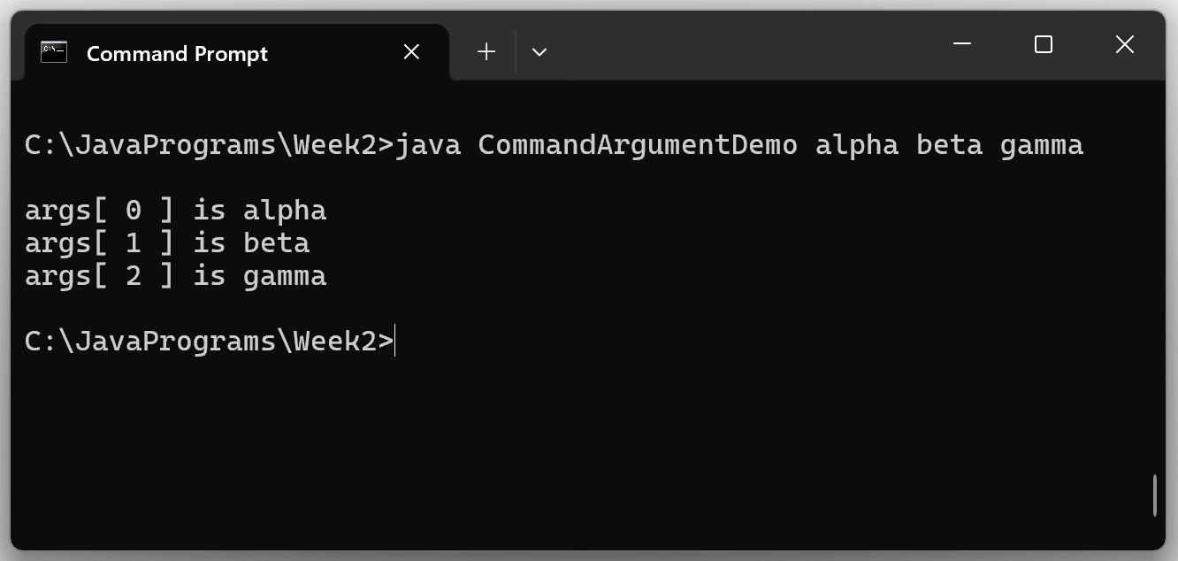
Handling Command Line Arguments
Sample Program Output

Slide 25
String Arrays
// Program to demonstrate String arrays
//
// Program Output: A penny saved is a penny earned
// A stitch in time saves nine
// A fool and his money are soon parted
public class StringArrayDemo
{
public static void main( String [] args )
{
String [] proverbs = { "A penny saved is a penny earned",
"A stitch in time saves nine",
"A fool and his money are soon parted"
};
System.out.println();
for( int j = 0; j < proverbs.length; j++ )
System.out.println( proverbs[j] );
}
}

Slide 26
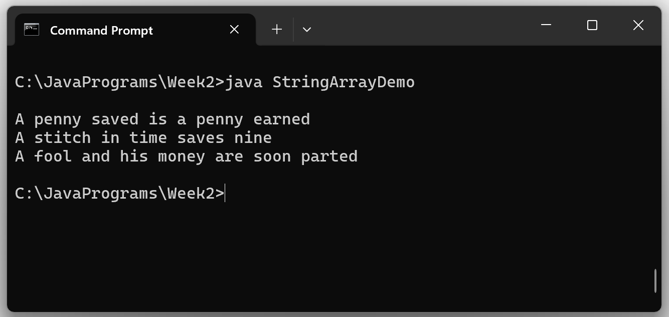
String Arrays
Sample Program Output

